Slide 1


Ansible: Inventory, Modules, & Playbook Essentials
Presenter
Mohammad Anees Alam
Notes:
1

Slide 2







Topics for Today!
Static & Dynamic Inventory
Common Ansible modules usage
Playbook: Variables & facts
Playbook: Conditions & loops
Variables, Facts, Conditionals, and Loops
Dedicated VARS for clean Ansible
Handlers
Notes:
2

Slide 3
Ansible Inventory Overview
Static Inventory
Dynamic Inventory
Simple text file listing hosts manually
Generated from scripts or plugins
  Easy to read and write
  Reflects real-time infrastructure
  No external dependency
  Scales to thousands of nodes
  Ideal for small environments
  Adapts to changes automatically
Notes:
3

Slide 4




Dynamic Inventory
Why Use Dynamic Inventories?
AWS Example
Other Providers
Use aws_ec2.yml configuration file
GCP: gcp_compute plugin
IP addresses change due to scaling or restarts
Azure: azure_rm plugin
Run: ansible-inventory -i aws_ec2.yml --graph
Manual updates aren't practical in cloud environments
Notes:
4

Slide 5

Static vs Dynamic Inventory
Feature
Static Inventory
Dynamic Inventory
Source of Hosts
Manually defined
Pulled from APIs
File Format
INI or YAML
Plugin config in YAML
Realtime Updates
Manual
Automatic
Use Case
Labs, static infra
Cloud, auto-scaling
Notes:
5

Slide 6
Dynamic Inventory Plugins
Provider | Plugin Name | Inventory File (YAML) | Sample CLI
AWS | aws_ec2 | aws_ec2.yml | ansible-inventory -i aws_ec2.yml --graph
GCP | gcp_compute | gcp.yml | ansible-inventory -i gcp.yml --graph
Azure | azure_rm | azure_rm.yml | ansible-inventory -i azure_rm.yml --graph
Plugin Execution:
When you run: ansible-inventory -i aws_ec2.yml --graph
Ansible:
Reads aws_ec2.yml, which defines how to connect to AWS (region, filters, credentials).
Queries AWS using Boto3 to fetch instance info.
Returns a structured inventory showing groups like:
@all:
|--@aws_ec2:
|-- 10.0.0.25
|-- 10.0.0.32
Notes:
5

Slide 7

Essential Ansible Modules
File Management
  file: Manage attributes
  copy: Copy files to nodes
  template: Render Jinja2 templates
Package Management
  apt: Debian/Ubuntu packages
  yum: CentOS/RHEL 7 packages
  dnf: RHEL 8+, Fedora packages
Service Control
  service: Manage services
  systemd: Control systemd services
Shell & User Management
  command/shell: Run commands
  user/group: Manage users/groups
Notes:
6

Slide 8
GUESS THE OPERATIONS OF THESE AD-HOC COMMANDS
1
ansible all -m file -a "path=/opt/testdir state=directory mode=0755"
2
ansible all -m copy -a "src=./index.html dest=/var/www/html/index.html"
3
ansible all -m apt -a "name=nginx state=present update_cache=true"
4
ansible all -m systemd -a "name=nginx state=started enabled=yes"
5
ansible all -m user -a "name=devops state=present"
6
ansible all -m shell -a "uptime"
Notes:
7

Slide 9






Ad-hoc Commands
Create Directory
ansible all -m file -a "path=/opt/testdir state=directory mode=0755"
Copy File
ansible all -m copy -a "src=./index.html dest=/var/www/html/index.html"
Install Package
ansible all -m apt -a "name=nginx state=present update_cache=true"
Start Service
ansible all -m systemd -a "name=nginx state=started enabled=yes"
Add a user
ansible all -m user -a "name=devops state=present"
Run a shell command
ansible all -m shell -a "uptime"
Notes:
8

Slide 10








Variables, Facts, loops & Conditionals
Variables
Facts
Make playbooks dynamic and reusable
System information gathered automatically
Define in playbooks, inventory, or separate files
Access via ansible_facts dictionary
Loops
Conditionals
Run tasks multiple times with different values
Use when to run tasks conditionally
Example: when: ansible_facts['os_family'] == "Debian"
Example: loop: "{{ package_names }}"
Notes:
9

Slide 11
Let's analyze sample playbooks and understand how these concepts are applied, along with Hands-on.
Notes:
10

Slide 12



Variable Organization
Playbook Variables
Defined directly in playbooks under vars section
group_vars
Variables for groups of hosts in group_vars directory
host_vars
Host-specific variables that override group variables
Notes:
11

Slide 13

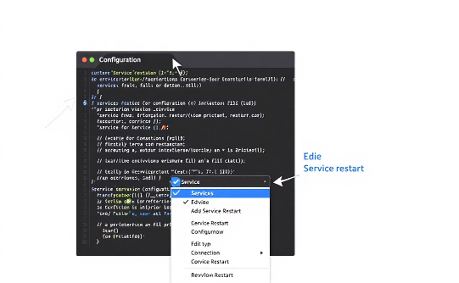
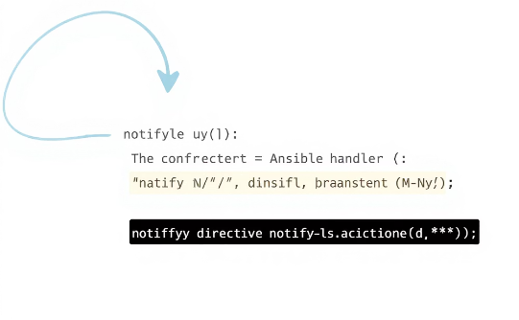
Handlers in Ansible
What Are Handlers?
Use Case Example
Implementation
Special tasks triggered by notifications from other tasks
Modify configuration files with templates
Define handler’s section in playbook
Use notify directive in tasks to trigger handlers
Only run at the end of a play if notified
Restart services only when configs change
Notes:
12

